Slide 1
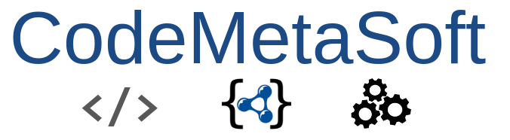





CodeMetaSoft
Funded Project
Principal Co-Investigator: Daniel Garijo, Universidad Politécnica de Madrid
Principal Co-Investigator: Thomas Vuillaume, Laboratoire d'Annecy de Physique des Particules, CNRS
Project team members: Tom Francois, Anas el Hounsri, Esteban González Guardia
Implemented by

Slide 2
CodeMetaSoft
Improving Research Software metadata good practices across OSCARS science clusters
OSCARS Funding:
€ 250000
Project Start:
01-Nov-2024
Project End:
01-Nov-2026
Field:
All clusters Research Software Metadata
Principal Investigators:
Daniel Garijo, UPM Thomas Vuillaume, LAPP
Other Researchers involved:
Tom Francois, LAPP Anas el Hounsri, UPM Esteban González, UPM
Challenge addressed Ease the adoption of Research Software metadata & good practices Automate metadata propagation and interoperability Propose suggestions for researchers
Step 1
Step 2
Step 3
Step 4
Step 5
Assess the current adoption of practices
Gap analysis and pitfall collection
RS Metadata enrichment methodology
Implement suggestions on Science clusters repos
Demos in OSSR, workflows, actions
IMPACT
Improving metadata adoption and FAIR4RS principles in European Science clusters, increase the adoption of CodeMeta as a Research Software metadata standard
Organisations involved:

Slide 3
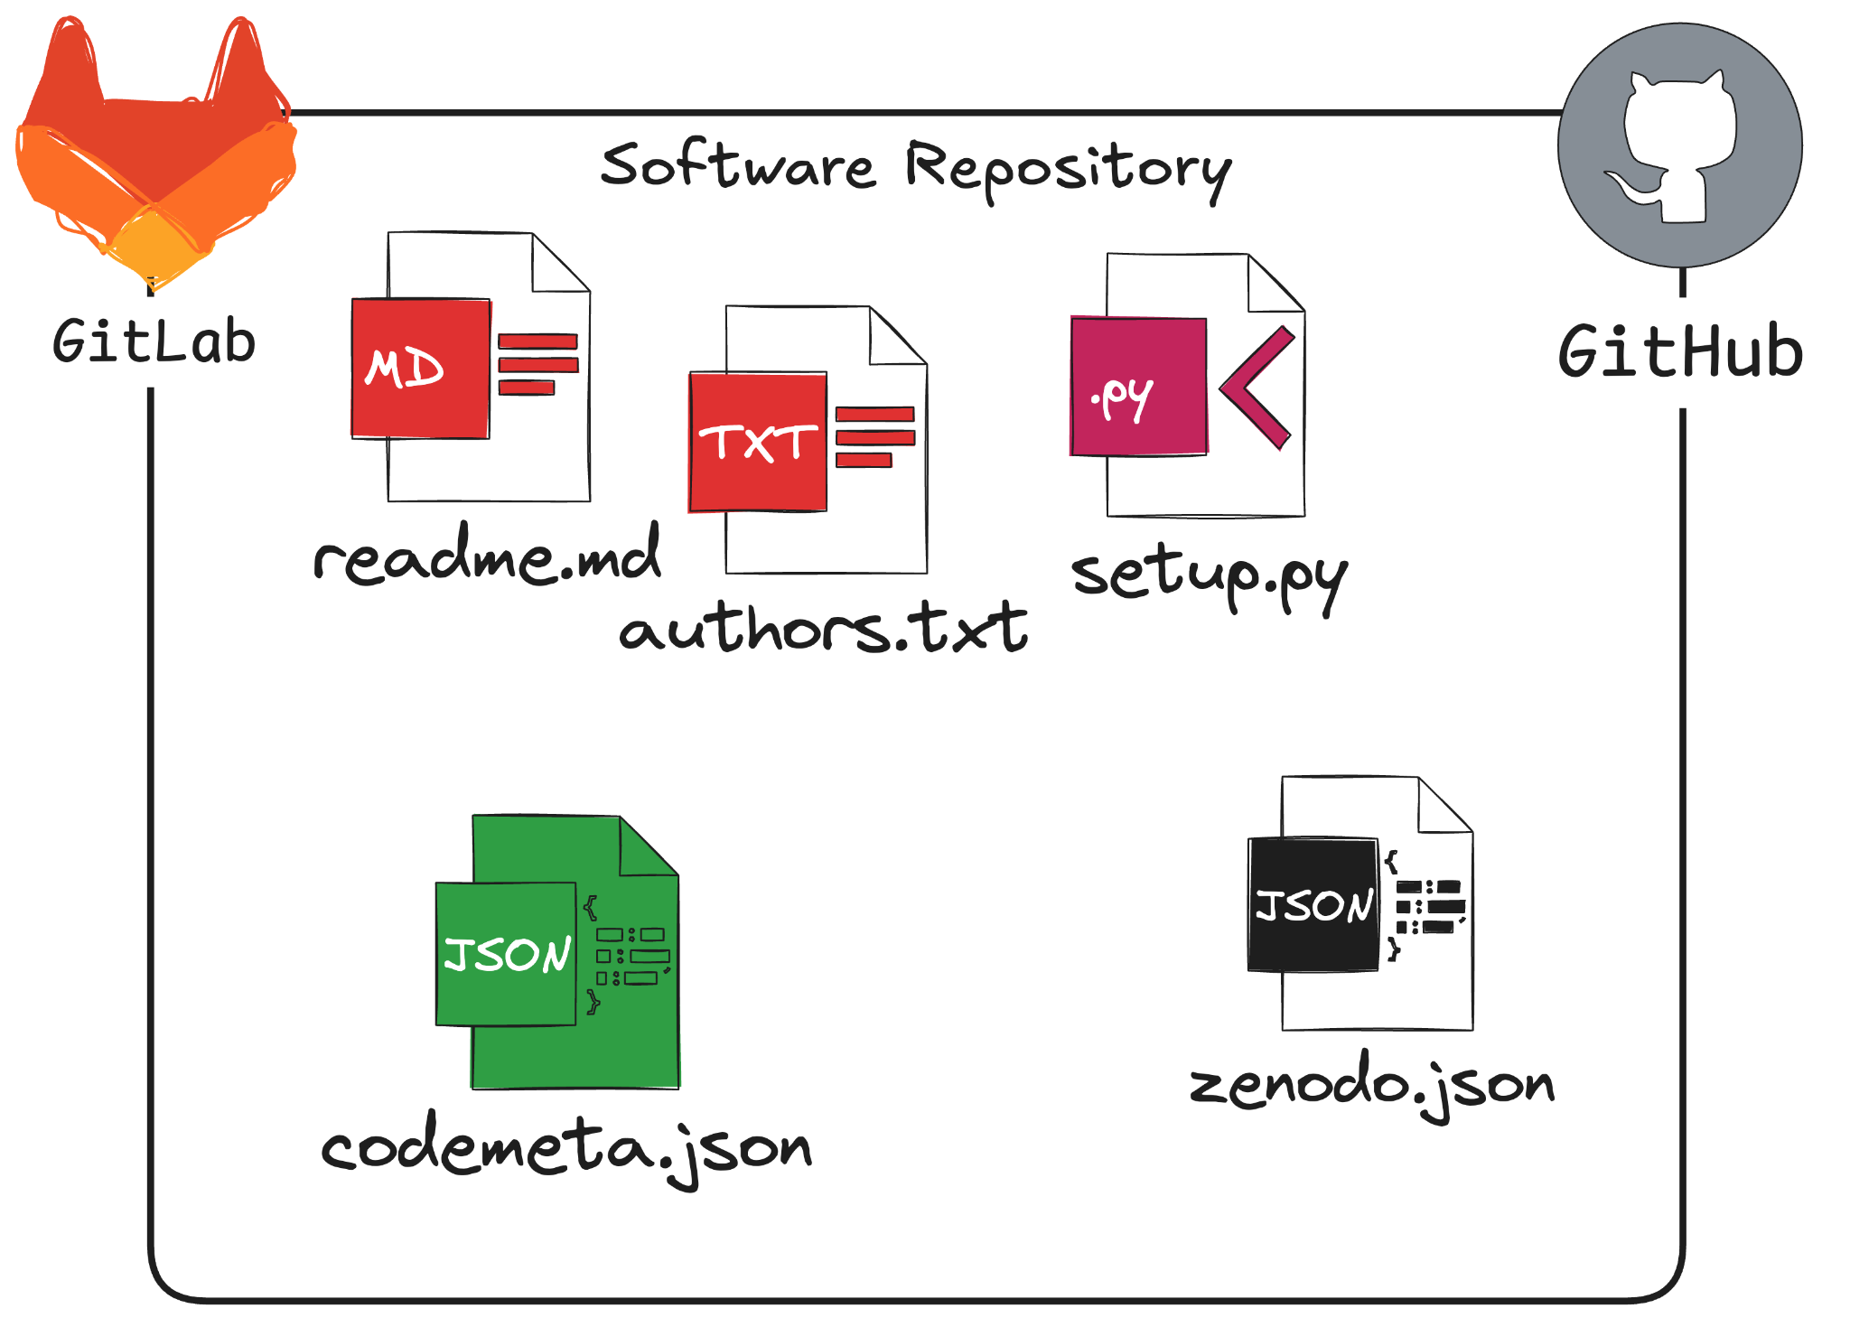
Context
Research Software metadata are a core element of FAIRness.
Sources of software metadata are often project or platform specific.
setup.py, setup.cfg in python
pom.xml in Java
README.md
…
CodeMeta is becoming the metadata standard for software metadata.

Slide 4
Challenge Addressed
Software metadata is currently disseminated in heterogeneous files and documentation
Lack of automated suggestions and enrichment for improving software metadata

Slide 5
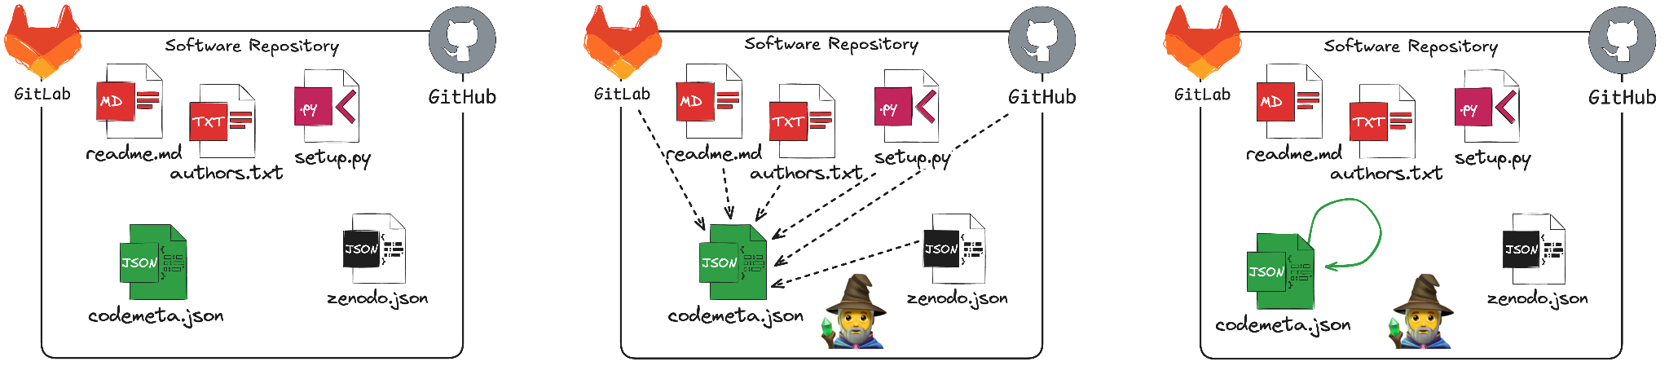
Proposed Solution
Integrate and enrich Research Software (RS) metadata records
Tools to ease metadata compliance, propagation and automated suggestions and enrichment
Automate RS metadata maintenance workflows
Means to measure metadata gaps and the adoption of best practices
Methodology for RS enrichment
Demonstrators through clusters and OSSR

Slide 6
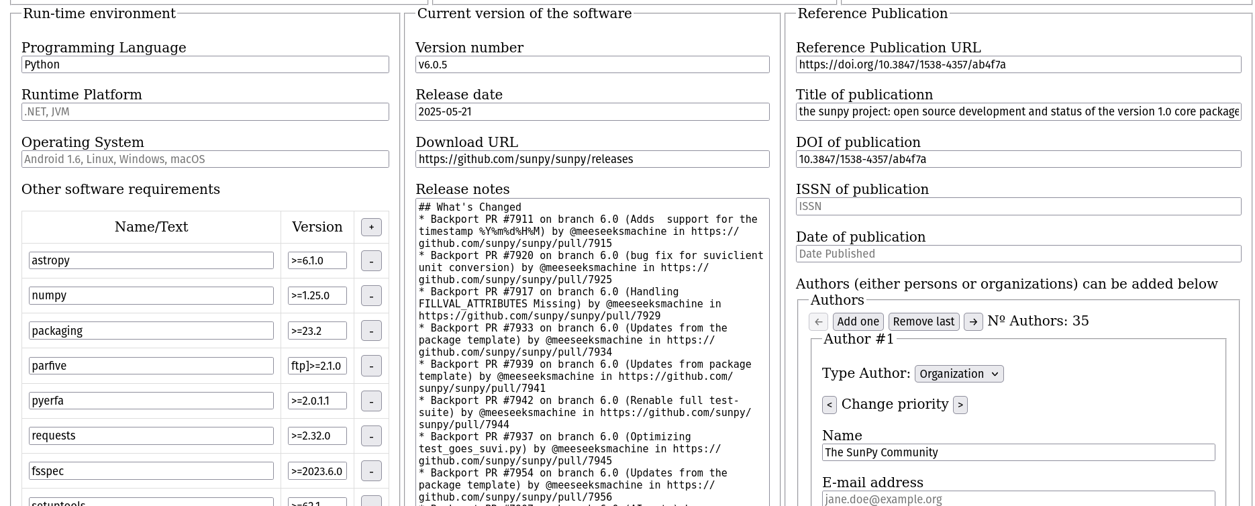
Work done so far
Auto-codemeta wizard: https://autocodemeta.linkeddata.es/

Slide 7
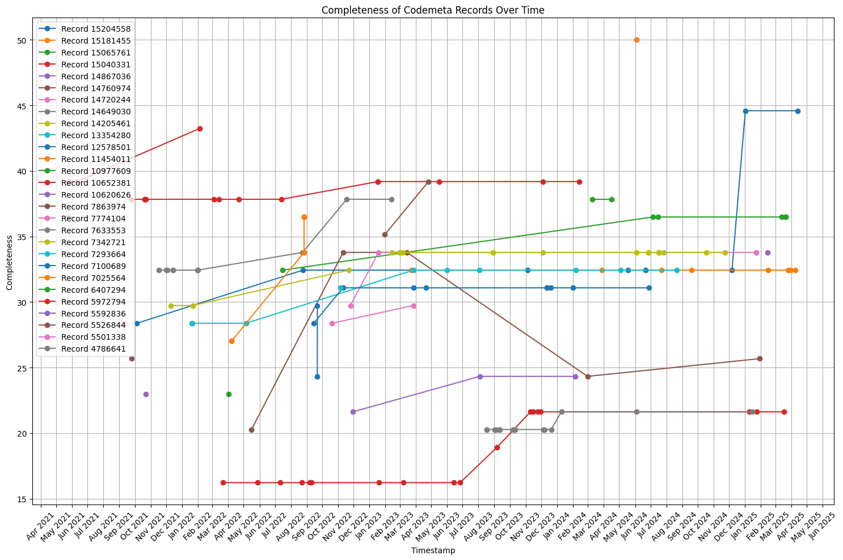
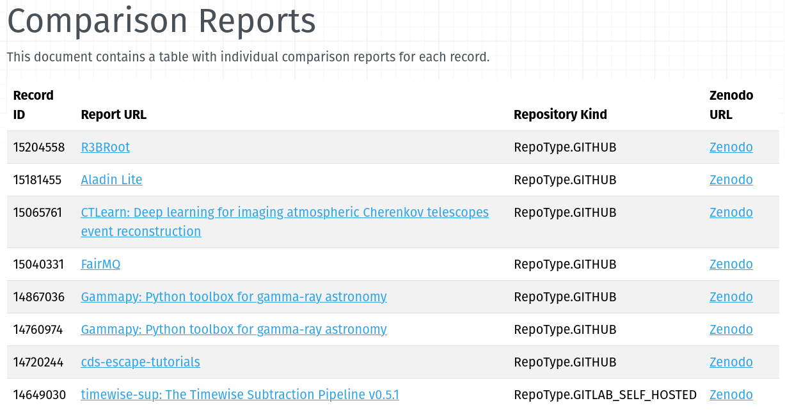
Metadata tracking reports
Metadata comparison reports: https://rs-quality-checks-2b2333.gitlab.io/records/report/

Slide 8
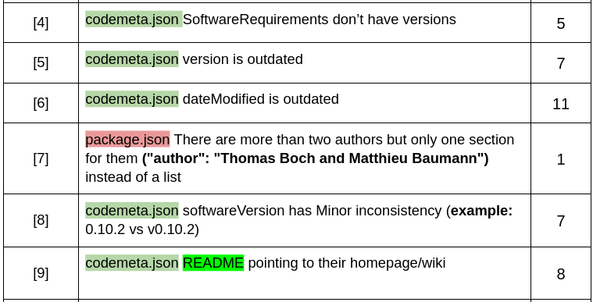
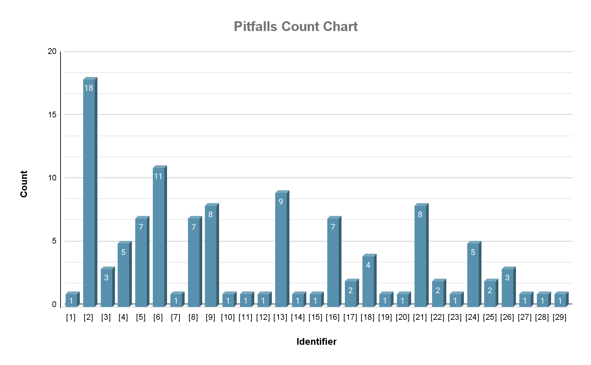
Work done so far (2)
Metadata pitfall catalog (in progress)

Slide 9
Integration with PaNOSC resources
PaN software catalogue https://software.pan-data.eu/software
Reused for landscape analysis of best practices [1]
To integrate: European Photon and Neutron open data search portal
Will be used for expanding landscape analysis
Next steps:
Extend pitfall analysis to PaN catalogs
Extend metadata completeness analysis to PaN catalogs
[1] El Hounsri, Anas and Garijo, Daniel. Good practice versus reality: A landscape analysis of Research Software metadata adoption in European Open Science Clusters. To appear in Proceedings of the Mining Software Repositories Conference, 2025. Association for Computing Machinery. MSR '25. 2025. https://dgarijo.com/papers/El_Hounsri_MSR_2025_landscape_analysis_CR.pdf

Slide 10
Next Steps & Expected Scientific Impact
What is going to change thanks to your project?
CodeMeta maintenance in software repositories is simplified. As a result its adoption in the Science Clusters increases, making software more FAIR globally.
Gaps in metadata are identified in software catalogues, helping Science Clusters focusing their efforts where they are most needed
Resources that will be made available:
Open service(s) and actions usable by others from any community
Sustainability:
Rely on existing tooling (e.g., CodeMeta generator) and standards (CodeMeta)
The developed solution and results will be open-source and published in Zenodo to be (re)usable by anyone.
A first landscape analysis of good practices has been accepted at MSR’25 [1]
[1] El Hounsri, Anas and Garijo, Daniel. Good practice versus reality: A landscape analysis of Research Software metadata adoption in European Open Science Clusters. To appear in Proceedings of the Mining Software Repositories Conference, 2025. Association for Computing Machinery. MSR '25. 2025. https://dgarijo.com/papers/El_Hounsri_MSR_2025_landscape_analysis_CR.pdf

